Slide 1
JOB PORTAL
SUBMITTED BY:
Arpana Tyagi, Bharti Bauhara,
Sharmistha Bhardwaj, Varun Sharma.

Slide 2
ABOUT
Job Portal provides the Job Seeker a platform for finding the right and satisfactory job according to their qualification. It provides the bridge between the job seeker and job provider.
The Objective of our Application is to develop a System which Job Applicants and Recruiters can communicate with each other.
Our system provides Job Catalogue and Information to its Users and helps them to decide with jobs to apply. The Admin and Employer can keep the Job Catalogue updated all the time so that the Job seekers get the updated information all the time.
Online Job Portal provides fast operations and provides Ease to its Users.

Slide 3
Modules :
ADMIN
Employer(HR)
USER
Fetch Data of HR, User, Job.
Validate Data.
Show or Delete data.
Post Job
Update Job
Delete Job.
Get Resume of Job Seekers.
Search their targeted Job, Apply for it & Post Resume.

Slide 4
Module Description:
Job portal is an application which connects Employer, Admin & Job Seekers where
Admin can fetch HR information & data, Job Seeker information & data, Job information & data. Admin can validate the data & info and also can show or delete it.
Employer(HR) are source of resources who can Post Job, Update Job, Delete Job & get Resume of Job Seekers.
Job Seekers after Registering and Logging In can Search their targeted Job, Apply for it & Post Resume.

Slide 5
Software Used :
Operating System : Windows 10.
Front End : Bootstrap, CSS, Java Script.
Framework : Spring Boot.
Back End : JPA, JSP, Java.

Slide 6
*UML Representation* :
1. CLASS
DIAGRAM

Slide 7
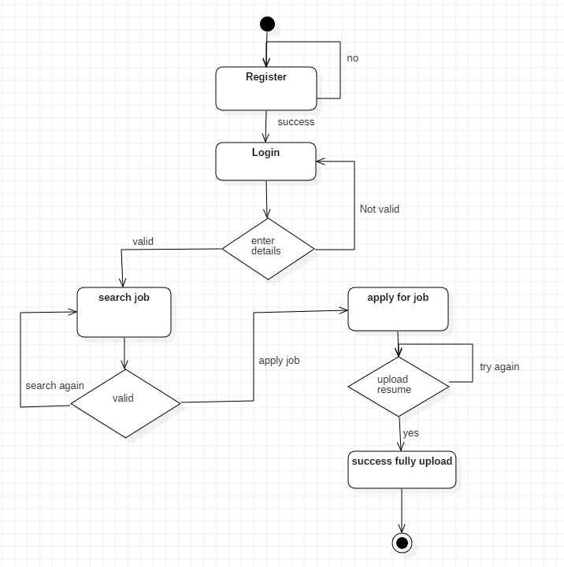
2. ACTIVITY
DIAGRAM
USER

Slide 8
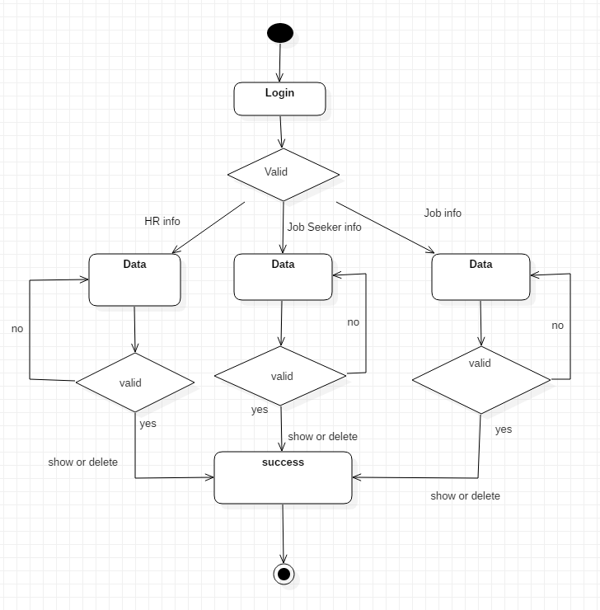
3. ACTIVITY
DIAGRAM
ADMIN

Slide 9
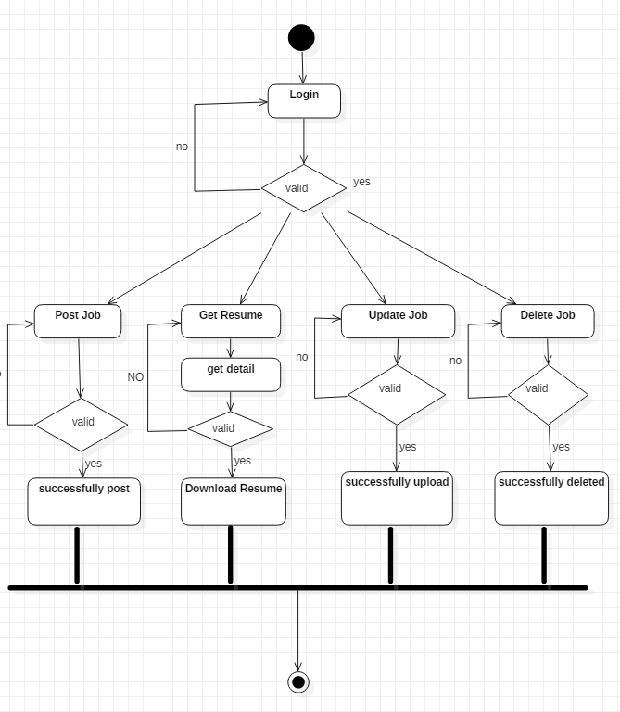
4. ACTIVITY
DIAGRAM
HR

Slide 10
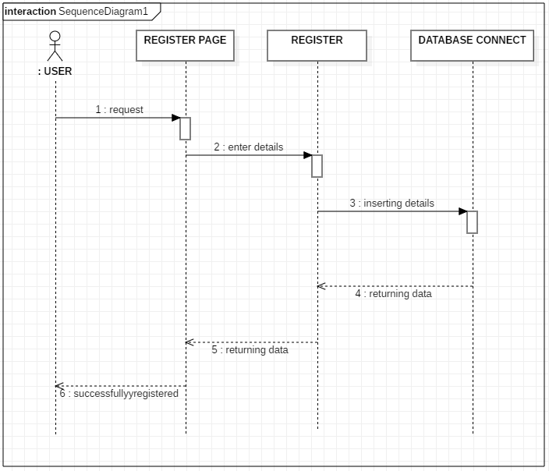
5. SEQUENCE DIAGRAM
(REGISTER)

Slide 11
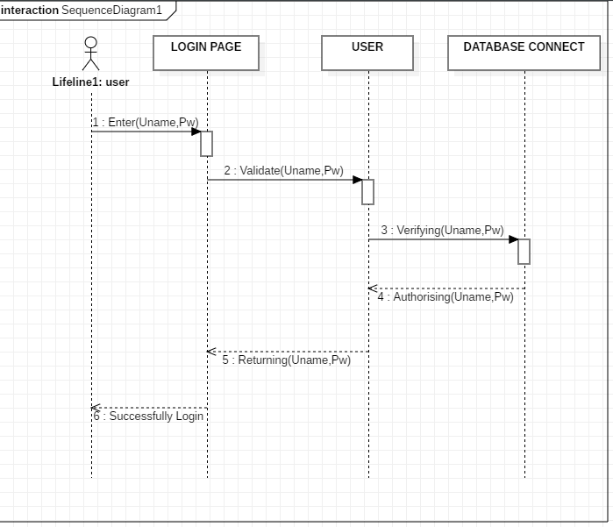
6. SEQUENCE DIAGRAM
(LOGIN)

Slide 12
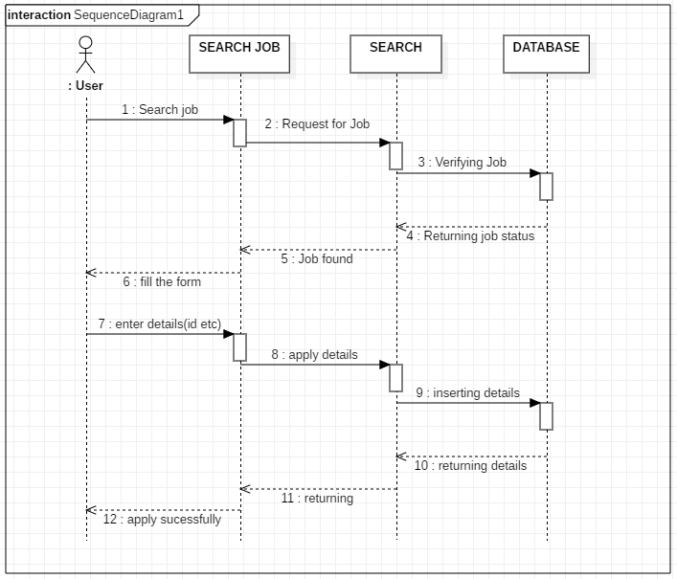
7. SEQUENCE DIAGRAM
(USER)

Slide 13
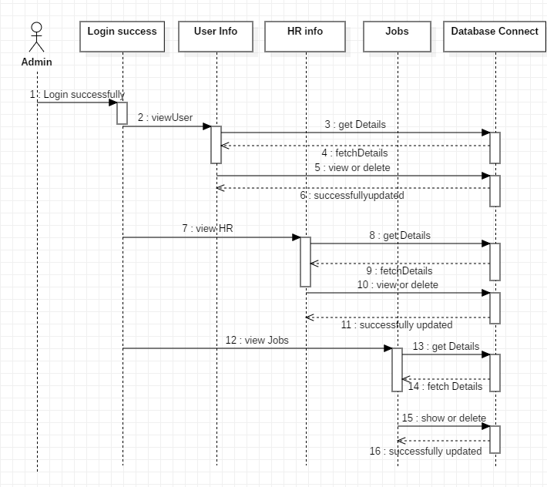
8. SEQUENCE DIAGRAM
(ADMIN)

Slide 14
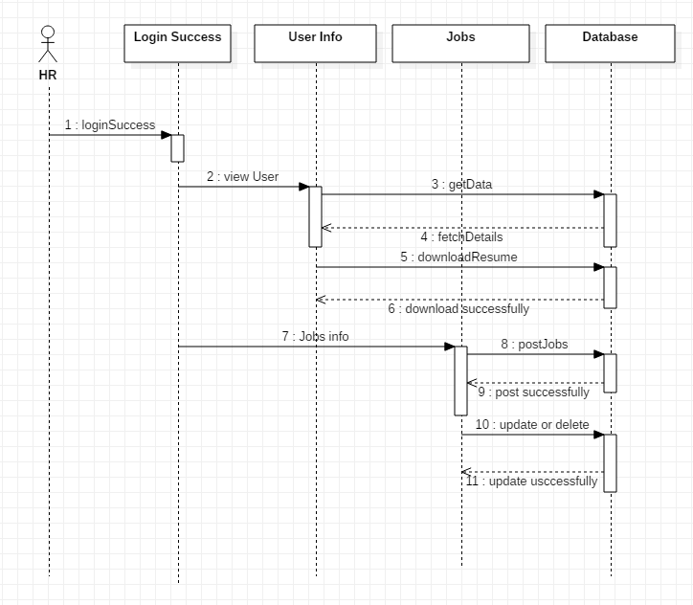
9. SEQUENCE DIAGRAM
(HR)

Slide 15

THANK YOU..

Slide 16


